Slide 1

Data Exploration Report
HOME CREDIT DEFAULT RISK
The source of data
Feature list and their descriptions
Statistical exploration of features
ML methods
Berk Filcan
Mehmet Akif Güçlü
Nihal Temüge
Beyza Yakıcı
Büşra Yavuz

Slide 2
The Source of Data
The data we use: https://www.kaggle.com/c/home-credit-default-risk/data
This data is provided by Home Credit on Kaggle. Our objective is to forecast whether an applicant will be able to make his/her payments based on historical loan application data.
Sources of data:
application_train/application_test
bureau
bureau_balance
previous_application
POS_CASH_BALANCE
credit_card_balance
installments_payment

Slide 3
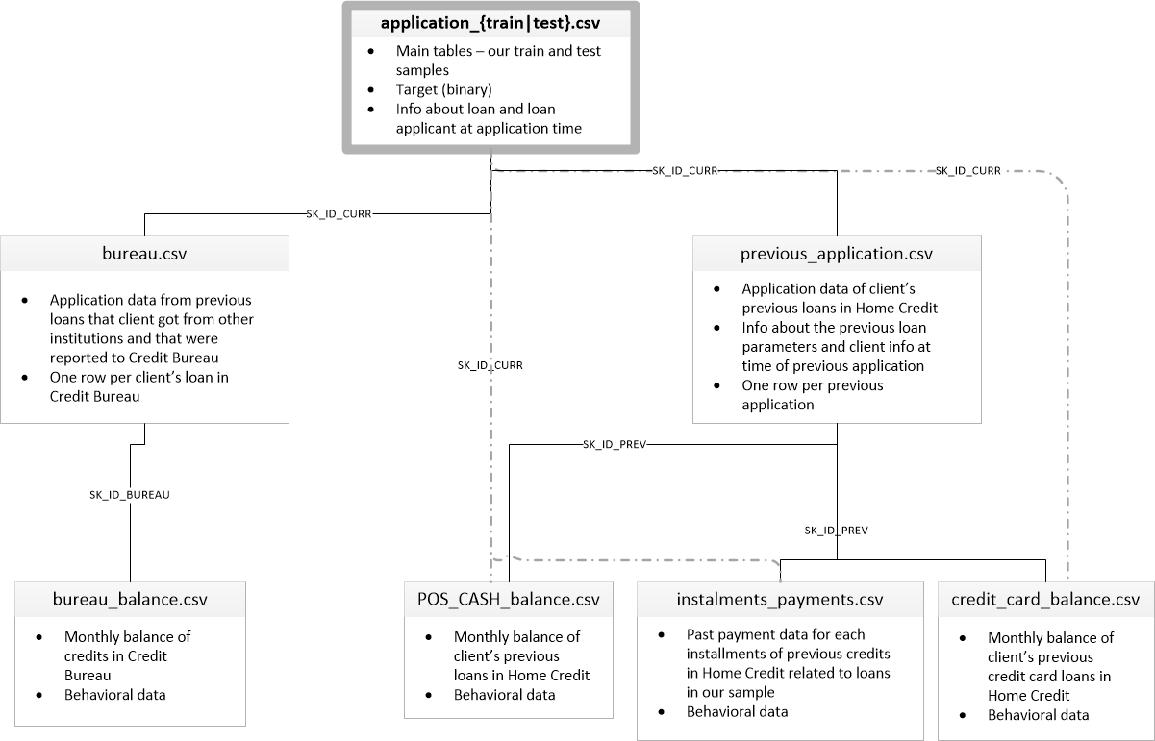
Feature List and Their Descriptions

Slide 4
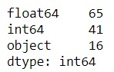
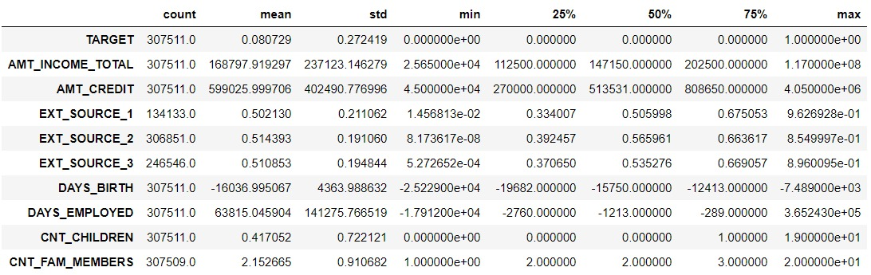
Statistical Exploration of Features
We have 122 colums in total;
65 of them are float
41 of them are integers
the rest is categorical.
We showed the main statistics for the most important columns below.

Slide 5
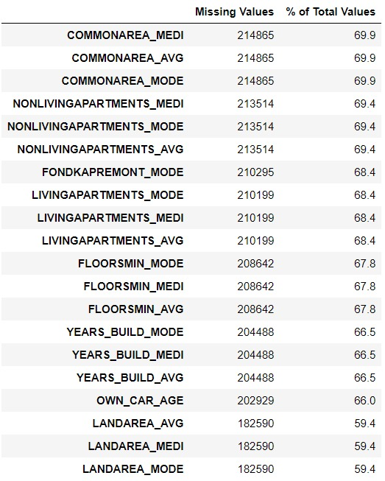
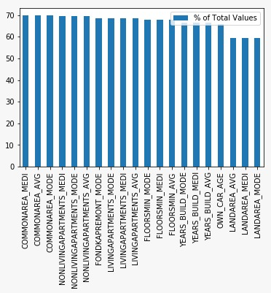
When it comes time to build our machine learning models, we will have to fill in these missing values (known as imputation). We will keep them for now.

Slide 6
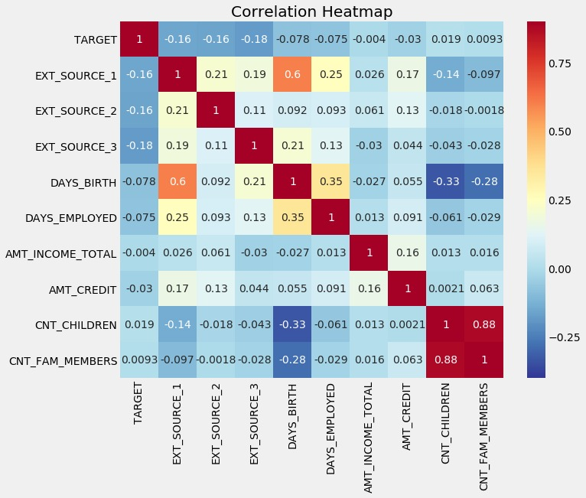
The high correlation between CNT_CHILDREN and CNT_FAM_MEMBERS is since family members depend on the number of children.
The correlation between DAYS_BIRTH and EXT_SOURCE_1 is 0.6 which might be because the latter is calculated using the former.

Slide 7
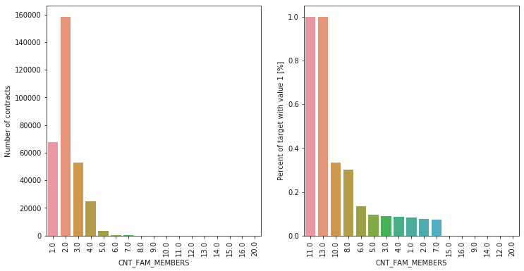
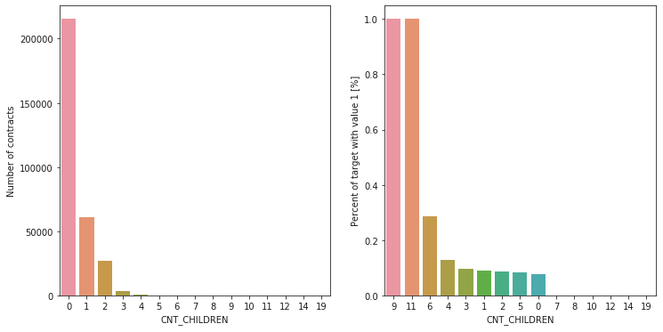
Number of family members of client and Number of children
Clients with family size of 11 and 13 have 100% not repayment rate. Families with 6 or less members have repayment rates close to the 10% average.
Most of the clients taking a loan have no children. As for repayment, clients with no children, 1, 2, 3, and 5 children have percents of no repayment around the average (10%). The clients with 4 and 6 children are above average in terms of percent of not paid back loans.

Slide 8
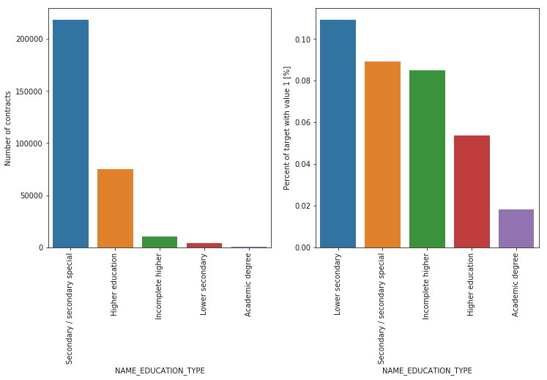
Education type of the client
Majority of the clients have Secondary / secondary special education, followed by clients with Higher education. Only a very small number having an academic degree.
The Lower secondary category, although rare, have the largest rate of not returning the loan (11%). The people with Academic degree have less than 2% not-repayment rate.

Slide 9
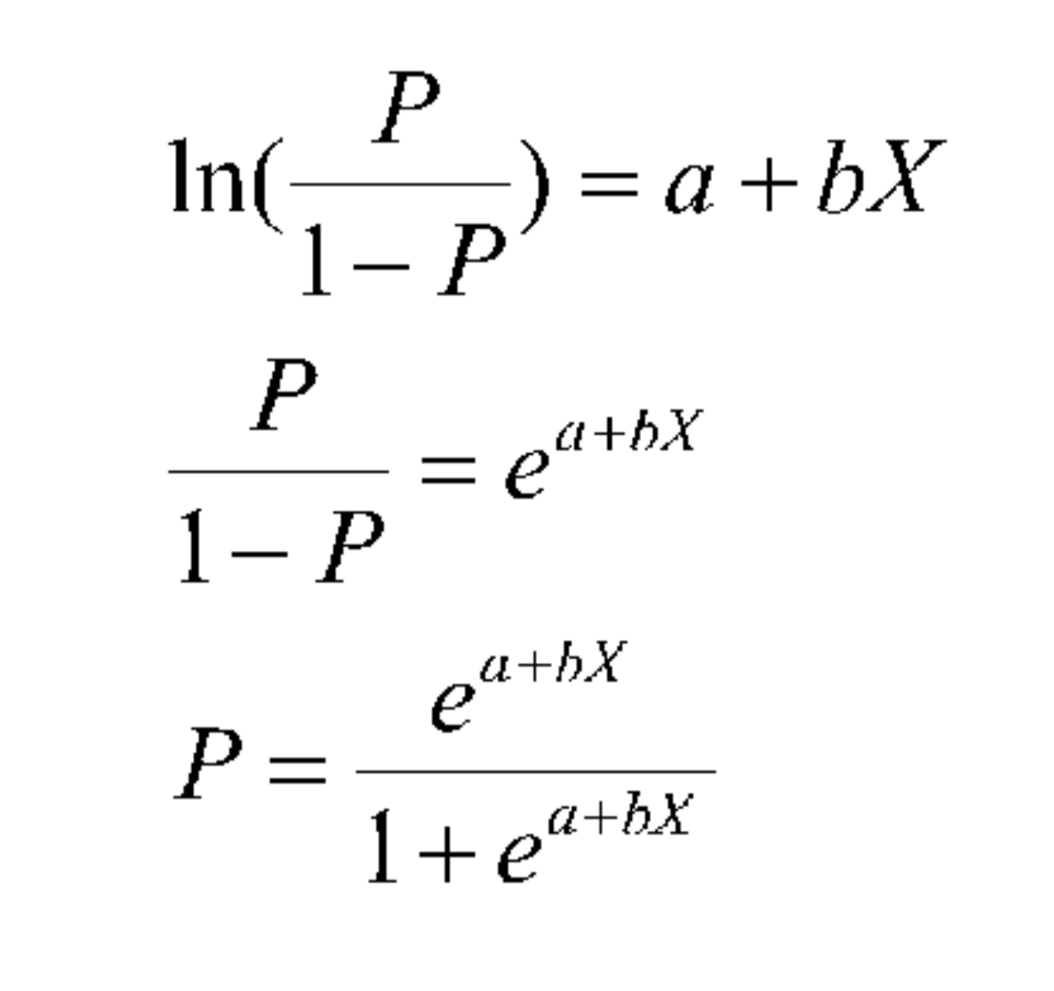
ML method we are going to use and details
We are going to use Logistic Regression as a ML model.
In this model, our aim is to classify
whether the credit will default or not.
We will end up with binary results.
We will apply Logistic Regression (Logit)
and Random Forest
We will use Scikit - Learn which is a free software machine learning library for the Python programming language and features various classification , regression and clustering algorithms.

Slide 10
How are we going to employ? RANDOM FOREST
Random forest is a type of supervised machine learning algorithm based on ensemble learning in which you join different types of algorithms or same algorithm multiple times to form a more powerful prediction model.
The random forest algorithm combines multiple algorithm of the same type i.e. multiple decision trees, resulting in a forest of trees, hence the name "Random Forest".

